Slide 1
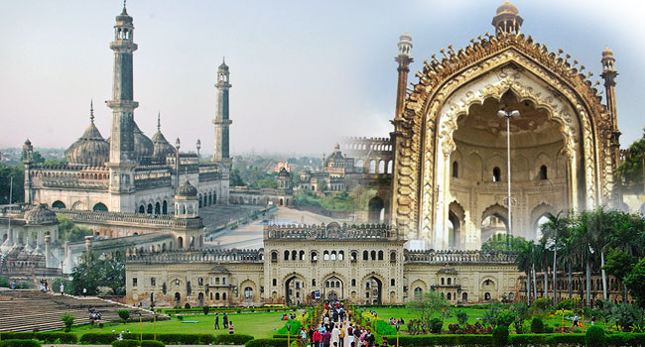
Lucknow – The City of Nawabs
Largest city and Capital of Uttar Pradesh. Second largest city on North, East and Central India- after Delhi.
As reported by Census of India 2011, Lucknow city has a population of around 2.9 million.
Known as multicultural city that flourished as North Indian cultural and artistic hub.
Important centre of governance, administration, education, commerce, aerospace, finance, pharmaceuticals, technology, design, culture, tourism, music and poetry.
Bounded on the east by the Barabanki, on the west by Unnao, on the south by Raebareli and in the north by Sitapur and Hardoi, Lucknow sits on the northwestern shore of the Gomti River.
Hindi is the main language of the city and Urdu is also widely spoken.
Lucknow, along with Agra and Varanasi, is one of the 3 cities in the which is a chain of survey triangulations created by the Government Of Uttar Pradesh to boost tourism in the state.
It is accessible from every part of India by air, rail and road.

Slide 2
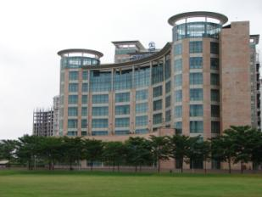
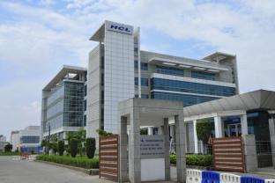
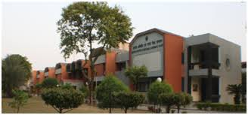
Economy
The major industries in the Lucknow Urban Agglomeration include aeronautics, machine tools, distillery chemicals, furniture and Chikan embroidery.
Lucknow is also a major centre for research and development as home to the prominent R&D centres of the National Milk Grid of the National Dairy Development Board, the Central Institute of Medical and Aromatic Plants, the National Handloom Development Corporation and U.P. Export Corporation.
Ranked sixth in a list of the ten fastest growing job-creating cities in India according to a study conducted by Assocham Placement Pattern.
Lucknow is among the top 15 cities of India by GDP.
Lucknow is a growing IT hub with software and IT companies resident in the city.
  Tata Consultancy Services is one of the major companies with its campus in Gomti Nagar, which also is the second-largest such establishment in Uttar Pradesh.
  HCL Technologies also started its training program with 150 candidates in April 2016 at HCL Lucknow campus.
  The city is also home to a number of important national and state level headquarters for companies including Sony Corporation and Reliance Retail.
  A sprawling 100 acres (40 ha) IT city is planned by the state government at the Chak Ganjaria farms site on the road to Sultanpur and they have already approved special economic zone status for the project, which is expected to create thousands of job opportunities in the state.
The city has enormous potential in the handicrafts sector and accounts for 60 percent of total exports from the state. Major export items are marble products, handicrafts, art pieces, gems, jewellery, textiles, electronics, software products, computers, hardware products, apparel, brass products, silk, leather goods, glass items and chemicals.
Tata Consultancy Services
HCL Technologies
Central Institute of Medical
And Aromatic Plants

Slide 3
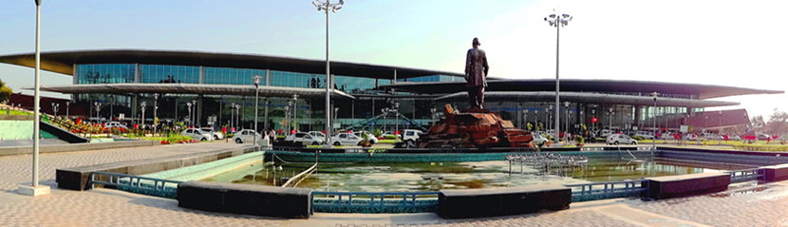
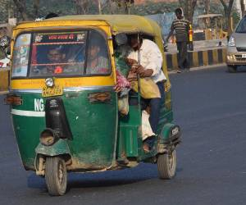
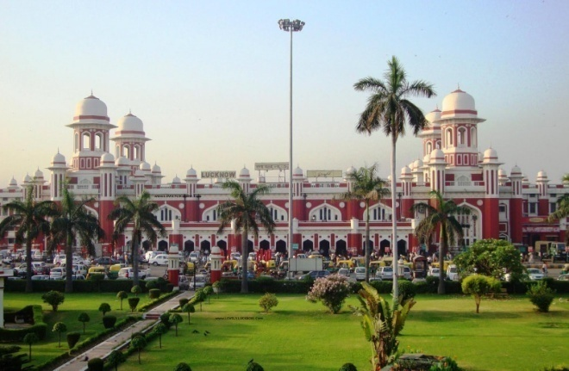
Transport
Roads - Four Indian National Highways originate at Lucknow's Hazratganj intersection: NH-24 to Delhi, NH-24B to Allahabad, NH-25 to Shivpuri via Jhansi, NH-56 to Varanasi and NH-28 to Barauni. Multiple modes of public transport are available such as taxis, city buses, cycle rickshaws, auto rickshaws and compressed natural gas (CNG) low floor buses.
City bus - Lucknow city's bus service is operated by Uttar Pradesh State Road Transport Corporation (UPSRTC), a public sector passenger road transport corporation headquartered in MG road. It has 300 CNG buses operating in the city out of an overall fleet of 9,500. There are around 35 routes in the city.
Inter-state buses - The major Dr. Bhimrao Ambedkar Inter-state Bus Terminal (ISBT) in Alambagh provides the main inter and intrastate bus lines in Lucknow. Located on NH-25, it provides adequate services to ongoing and incoming customers. Kanpur Lucknow Roadways Service is a key service for daily commuters who travel back and forth to the city for business and educational purposes.
Railways - The main long-distance railway station is Lucknow Railway Station located at Charbagh. It acts as the divisional headquarters of the Northern Railway division. The city is an important junction with links to all major cities of the state and country. The city has a total of fourteen railway stations. All stations lie within the city limits and are well interconnected by bus services and other public road transport.
Airways - Direct air connections are available in Lucknow to New Delhi, Patna, Kolkata, Mumbai, Bangalore, Thiruvananthapuram, Hyderabad, Dehradun and other major cities via Chaudhary Charan Singh International Airport. International destinations include Abu Dhabi, Dubai, Muscat, Riyadh, Singapore, and Jeddah. There is also a plan for runway expansion. It is the 10th-busiest airport in India, busiest in Uttar Pradesh, and second-busiest in North India.
Metro - Chief Minister Akhilesh Yadav gave approval to set up a metro rail system for the state capital. It is divided into two corridors with the North-South corridor connecting Munshipulia to CCS International Airport and the East-West corridor connecting Charbagh Railway Station to Vasant Kunj. Construction of the first phase will be completed by 2016–17.
Chaudhary Charan Singh International Airport
Auto Rickshaw – Road transport
Charbagh railway Station

Slide 4
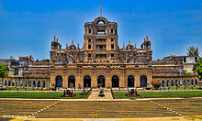
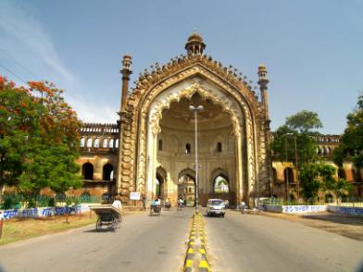
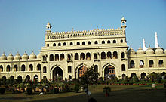
Architecture
Bara Imambara in Hussainabad is a colossal edifice built in 1784 by the then Nawab of Lucknow, Asaf-ud-Daula. It is the largest hall in Asia without any external support from wood, iron or stone beams.
The 60 feet (18 m) tall Rumi Darwaza, built by Nawab Asaf-ud-daula (r. 1775–1797) in 1784, served as the entrance to the city of Lucknow. It is also known as the Turkish Gateway, as it was erroneously thought to be identical to the gateway at Constantinople.
The Chattar Manzil, which served as the palace for the rulers of Awadh and their wives is topped by an umbrella-like dome and so named on account of Chattar being the Hindi word for "umbrella".
An example of mixed architectural styles is La Martiniere College, which shows a fusion of Indian and European ideas. Originally named "Constantia", the ceilings of the building are domed with no wooden beams used for construction. Glimpses of Gothic architecture can also be seen in the college building.
The Bara Imambara, Chhota Imambara and Rumi Darwaza stand in testament to the city's Nawabi mixture of Mughlai and Turkish style of architecture while La Martiniere college bears witness to the Indo-European style. Even the new buildings are fashioned using characteristic domes and pillars, and at night these illuminated monuments become the city's main attractions.
Around Hazratganj, the city's main market, there is a fusion of old and modern architecture. It has a multi-level parking lot in place of an old and dilapidated police station making way for extending the corridors into well-aligned pebbled pathways, adorned with piazzas, green areas and wrought-iron, tall, beautifully crafted cast-iron lamp-posts, reminiscent of the Victorian era, flank both sides of the street.
La Martiniere College
Rumi Darwaza
Bada Imambara

Slide 5
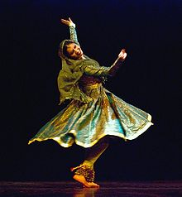
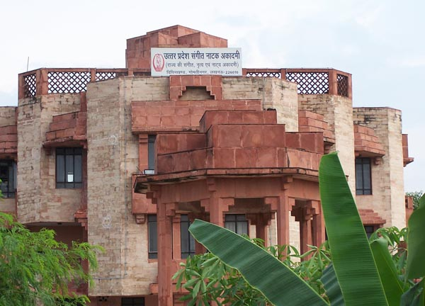
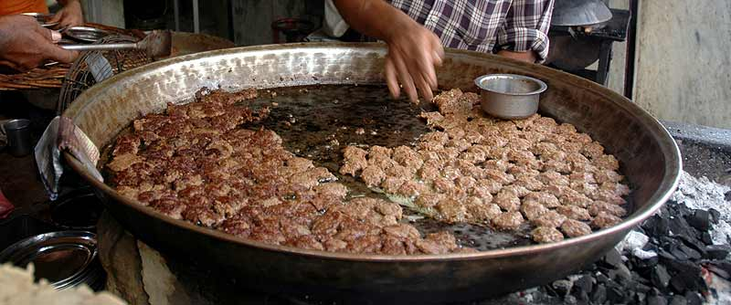
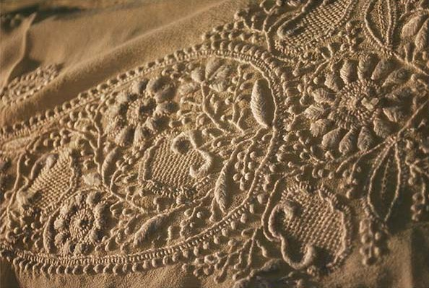
Culture
Awadhi, a dialect of the Hindi dialect continuum, has played an important role in Lucknow's history and is still used in the city's rural areas and by the urban population on the streets.
The Awadh region has its own distinct "Nawabi"-style cuisine. The best-known dishes of this area consist of biryanis, kebabs and breads. Kebabs are served in a variety of styles: kakori, galawati, shami, boti, patili-ke, ghutwa and seekh are among the available varieties. Sheermal is a type of sweet bread (paratha) prepared only in Lucknow.
The classical Indian dance form Kathak took shape in Lucknow. Lachhu Maharaj, Acchchan Maharaj, Shambhu Maharaj, and Birju Maharaj have kept this tradition alive.
Lucknow is known for embroidery works including chikankari, zari, zardozi, kamdani, and gota making (goldlace weaving). Chikankari is a popular embroidery work well known all over India. This 400-year-old art in its present form was developed in Lucknow and it remains the only location where the skill is practised today.
Kathak Dance form
Sangeet Natya Academy
Tunday Kebabs – Nawabi style cuisine
Chikankari

Slide 6
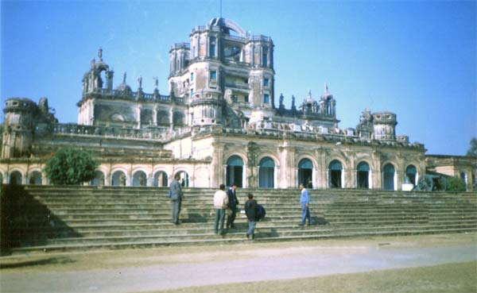
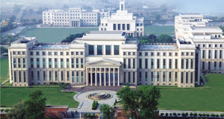
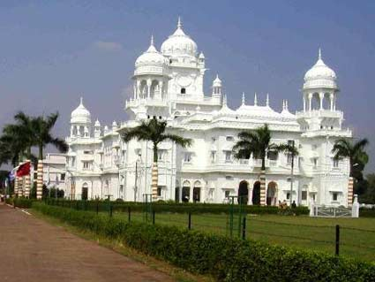
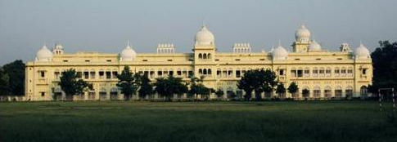
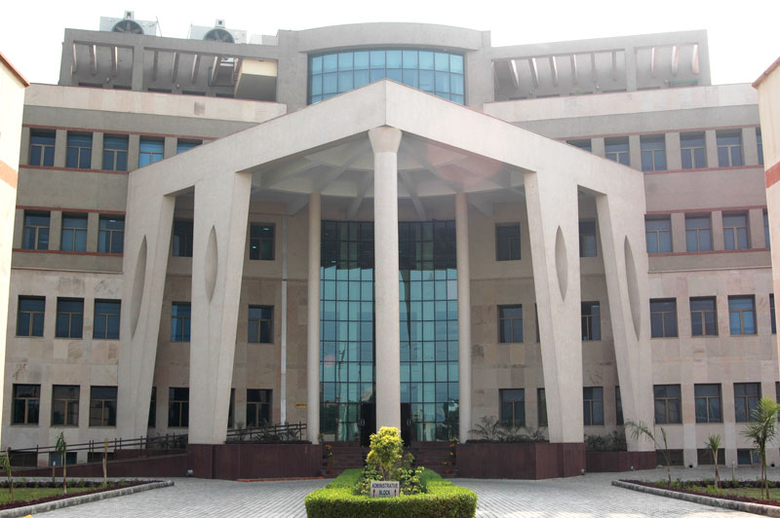
Education
Lucknow is home to a number of prominent educational and research organisations including: IIIT, IIM, IHM, CDRI, IITR, NBRI, IET, Dr. Ram Manohar Lohia National Law University, SGPGIMS and KGMU.
Some of Uttar Pradesh's major schools are located in Lucknow including: Mount Carmel College, City Montessori School, St. Francis' College, Loreto Convent Lucknow, St. Mary's Convent Inter College, Kendriya Vidyala, Seth M.R. Jaipuria School, Amity International School, St. Agnes, Army Public School, Study Hall, Christ Church College, Delhi Public School.
City Montessori School, with over 20 branches spread throughout the city is the only school in the world to have been awarded a UNESCO Prize for Peace Education. CMS also holds a Guinness World Record for being the largest school in the world with over 40000 pupil.
La Martiniere Lucknow, founded in 1845, is the only school in the world to have been awarded a battle honour. It is one of the oldest and most reputed schools in India, often ranked among the top 10 schools in the country.
The prestigious National P. G. College, affiliated to the University of Lucknow is ranked as the second best college imparting formal education in the country by the National Assessment and Accreditation Council.
La Martiniere College
Amity International School
Lucknow University
King George Medical College
Indian Institute of Management

Slide 7
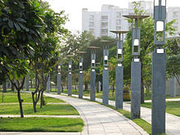
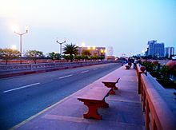
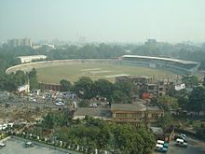
Parks and recreation
The city has parks and recreation areas managed by the Lucknow Development Authority.
These include Kukrail Reserve Forest and the surrounding picnic area, Begum Hazrat Mahal Park, Gautam Buddha Park, Qaisar Bagh, Rumi Park, Nimbu Park, Sardar Ballabh Bhai Patel Park, Dream Valley Resort, Swarn Jayanti Smriti Vihar Park, Dr. Ram Manohar Lohia Park, the Ambedkar Memorial.
Janeshwar Mishra park upon completion, would be the largest park in Asia. It boasts of lush greenery, a man-made lake, India's longest cycling and jogging track and a variety of flora.
Plan is also to set up a giant Ferris wheel inside the park on the lines of London Eye, which would provide a panoramic view of the city.
Lohia Path
Sports
Lucknow is the Headquarter for the Badminton Association of India. Located in Gomti Nagar, It was formed in 1934 and has been holding national-level tournaments in India since 1936. Junior level Badminton players receive their training in Lucknow after which they are sent to Bangalore.
Lucknow Race Course in Lucknow Cantonment is spread over 70.22 acres (28.42 ha); the course's 3.2 kilometres (2.0 mi) long race track is the longest in India.
Lucknow Golf Club, on the sprawling greens of La Martinière College, is a well-known golf course while an international-level cricket stadium and academy project in the city is under construction in Gomti Nagar and is expected to host its first international match in 2017.
Marine Drive
K D Singh Babu Stadium

Slide 8
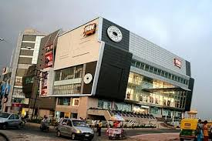
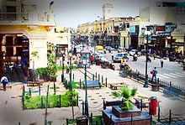
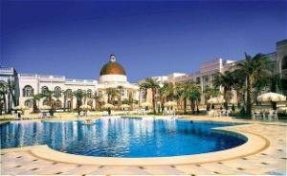
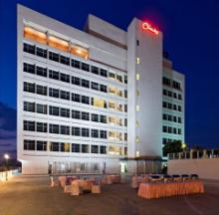
Shopping and Shopping Centres
Hazratganj is a major shopping area situated in the heart of the city, which is home to bazaars, retail complexes, restaurants, hotels, theatres and offices.
The Victorian-style street-lamps, benches on the footpath, numerous eating joints and generous landscaping attracts a lot of crowd during evenings.
Cultural and entertainment programs are held for the general public. Lucknow Police watches the crowd with the help of drone cameras.
Major shopping markets are also found in Yahiyaganj, Aminabad, Kapoorthala, Janpath, Chowk, Bhootnath, and Gomti Nagar.
Malls and Multiplexes like; Phoenix Mall, Saharaganj, Fun Republic, Wave Multiplex, INOX, Cinepolis; cover the most prime locations of Lucknow.
Fun Republic
Hotels
Hazratganj
Vivanta by Taj – This 5-star hotel has been built with the sophisticated Indian architecture. It lies in the heart of Lucknow, 8 km from Charbagh and 14 km from Airport, provides the top-end luxury to its guests.
Renaissance by Marriot – This 5-star hotel is the most recent addition to the exquisite lifestyle of the city. It is one in the long chain of international hotels of Marriot.
Dayal Paradise – This 4-star hotel is among the most luxurious hotels of Lucknow. Half an hour drive from Charbagh, this hotel provides premium lifestyle and excellent experience to its guests.
Clark Avadh – This 5-star hotel provides the most lavish living experience to its guests. It is one of the leading group of hotels in India and located ten minutes from Charbagh.
Vivanta by Taj
Clark Avadh

Slide 9
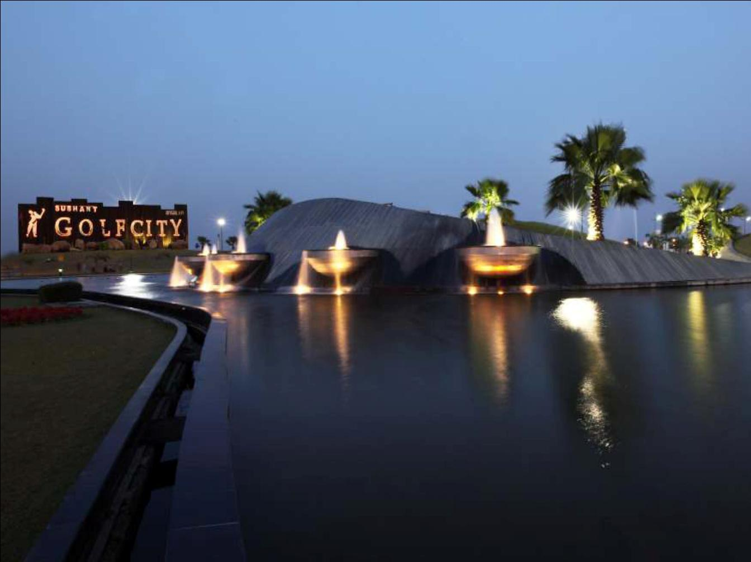


SUSHANT GOLF CITY
The HI– TECH TOWNSHIP,
Lucknow

Slide 10
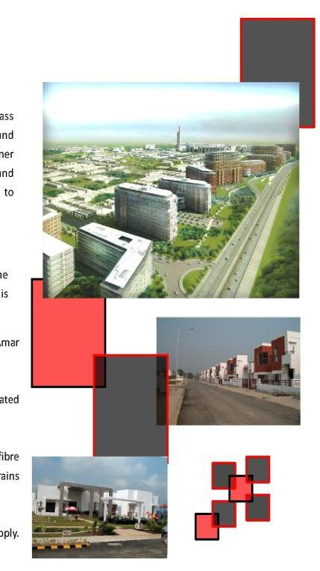

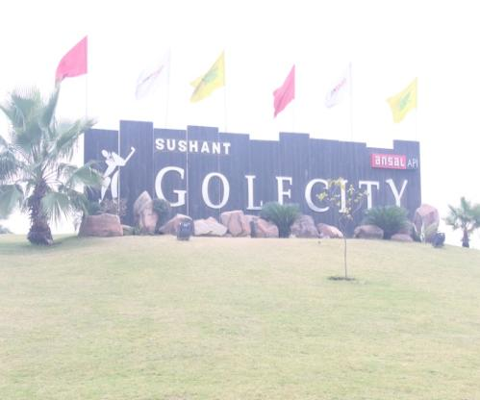
A hi-tech residential township sprawling across 6465 acres. A world class International championship golf course surrounds residential and commercial areas, making life on the greens a reality. Luxury villas, designer landscaping, state-of-the-art infrastructure, excellent entertainment and healthcare facilities, lush greens, everything here is specially designed to excel under the most discerning eye.
Key features of the core infrastructure
With Gomti Nagar on one side, and the city’s airport on the other, the location for Sushant Golf City will set new standards for all that is progressive and elegant.
Strategically located on the Lucknow-Sultanpur National Highway on Amar Shaheed Path, Ring Road.
Township is divided into manageable and compact sectors with regulated single entry/ exit points. Ample green cover and landscaping.
Paved roads with high quality riding surfaces. Underground optical fiber cables for telecommunication, electricity distribution, storm water drains and sewer systems.
Efficient power distribution network. Regulated, potable water supply. Solid waste management with participation of residents.

Slide 11
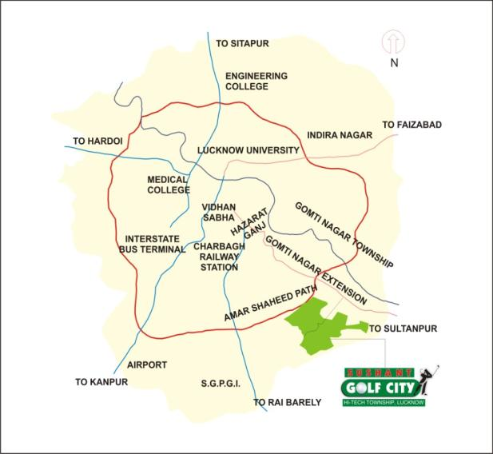
SUSHANT GOLF CITY – LOCATION MAP

Slide 12
Accessibility
Distance from-
Gomti Nagar 2-3 KM
International Airport 12 KM
Railway Station 10 KM
Hazratganj 9 KM
International Cricket
Stadium <1 KM
TOWARDS
HAZRATGANJ
TOWARDS
CHARBAGH
CIVIL
LINES
BUTLER
COLONY
LA MARTINERE
COLLG
CMS
CANTONMENT
AREA
GULISTAN
COLONY
VIKAS
KHAND
GOMTI NAGAR
ELDECO
TOWER
VIJAY
NAGAR
NH 56
VIVEK
KHAND
ROHTAS
TOWER
TCS
TOWARDS
AMBEDKAR
UNIV.
HODSON
LINES
ROBERT
LINES
EMAAR
MGF
VIRAM
KHAND
VIINAY
KHAND
VIBHUTI
KHAND-i
OMAXE
HEIGHTS
AMAR SHAHEED PATH
AMAR SHAHEED PATH FLY OVER
TO FAIZABAD ROAD
TOWARDS
AIRPORT
PROPOSED
STADIUM
VINEET
KHAND
VIBHUTI
KHAND-ii
BBD
BEST PRICE
WALMART
VIRAT
KHAND
JAIPURIA
INSTITUTE
AMITY
UNIV.
ICFAI
GD GOENKA
SCHOOL
HEART DIVINE
HOSPITAL
GOMTI NAGAR
EXTN.
TO SULTANPUR
HOMEOPATHIC
MEDICAL COLL.
APOLLO
HOSPITAL
SUSHANT GOLF
CITY
GOMTI NAGAR
IILM
MAP NOT TO SCALE

Slide 13
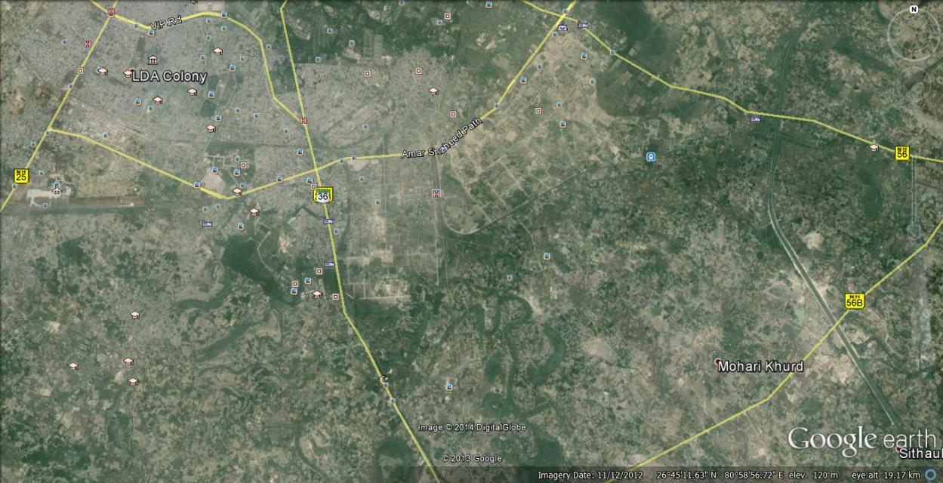
Location of Township on Satellite image
Sultanpur Road NH-56
Amar Shaheedpath
Kanpur Road NH-25
LDA COLONY
IT CITY
60 mtr. Wide
PHASE-1
AWADH VIHAR COLONY
PHASE-2
CHAUDHARY CHARAN SINGH AIR PORT
INDIRA CANAL
PHASE-3
SANJAY GANDHI POST GRADUATE INSTITUTE of MEDICAL SCIENCES
Raibarelly Road NH-24B

Slide 14
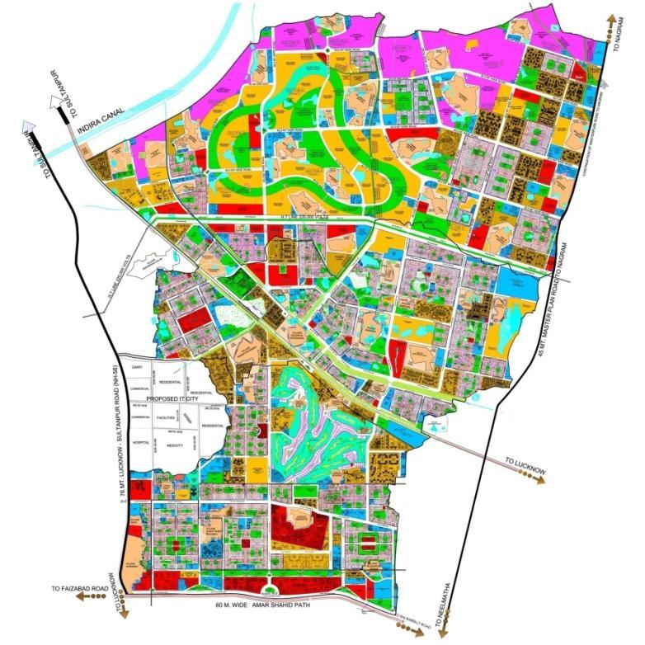
Internal Connectivity of the Township
TO SULTANPUR
TO NAGRAM
THROUGH
OUTER RING ROAD
TO SULTANPUR
FROM NAGRAM ROAD
THROUGH
30.0 MTR WIDE ROAD
THROUGH
LEVEL CROSSING ON
30.0 MTR. WIDE ROAD
2
FROM SULTANPUR ROAD THROUGH TWO 30 MTR. WIDE ROADS
FROM NAGRAM ROAD
THROUGH THREE NOS
45.0 MTR WIDE ROADS
B
45 MT. MASTER PLAN ROAD TO NAGRAM
PROPOSED
RAILWAY OVER BRIDGE
A
A
FROM SULTANPUR ROAD THROUGH
45.0 MTR WIDE MASTER PLAN ROAD
TWO 45.0 MT WIDE ROAD
STARTING FROM SHAHEED PATH AND
PASSING THROUGH THE TOWNSHIP &
CONNECTING THE EXTENDED AREA
BY TWO NOS ROB’S
76 MT. LUCKNOW-SULTANPUR ROAD(NH-56)
TO LUCKNOW
1
TO NEELMATHA
TO FAIZABAD ROAD
60 M. WIDE AMAR SHAHID PATH
TO LUCKNOW

Slide 15
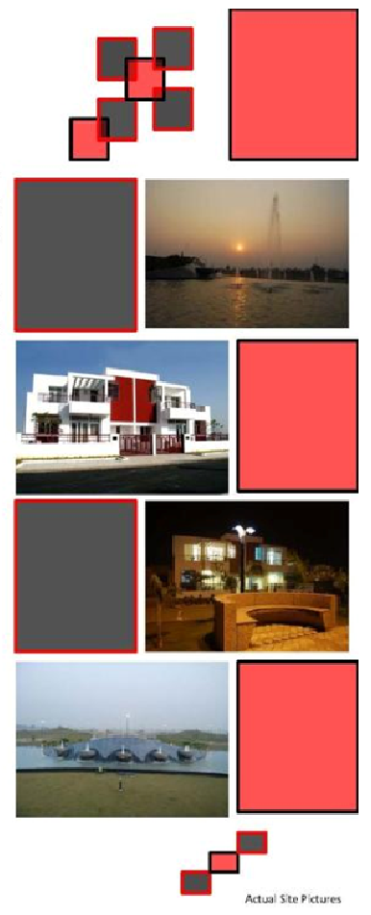
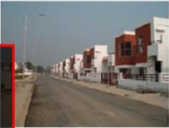
SUSHANT GOLF CITY – PRODUCTS
The township features number of different products:
Plots – Residential & Commercial
Villas/ Row Houses
Group Housing
Commercial Spaces/ Office Spaces
Commercial Business District
Health Centers and Hospitals
Community Facilities and Clubs
Schools and Institutions

Slide 16
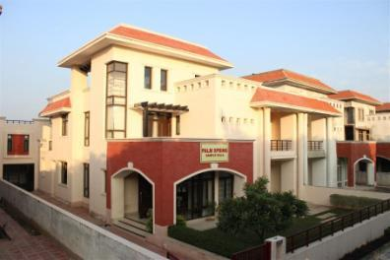
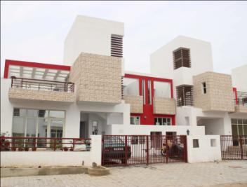
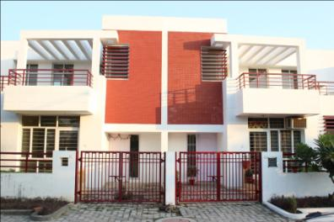
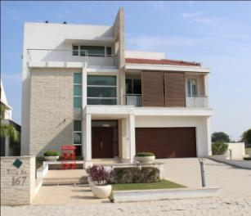
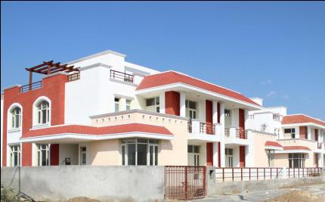
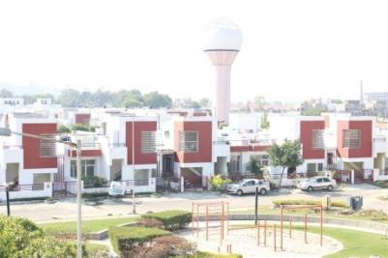
Actual Photographs of some constructed Villas in Sushant Golf City –
Palm Spring Ville
Charmwood
Rosewood
Golf Villa
Palm Grove Villa
Larchwood

Slide 17
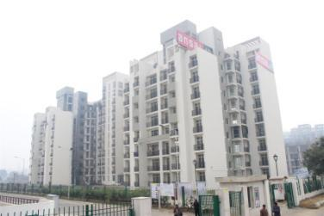
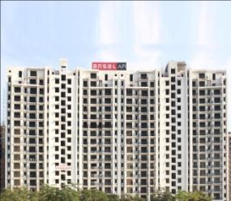
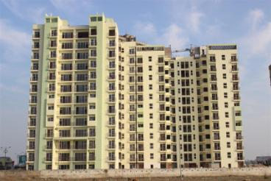
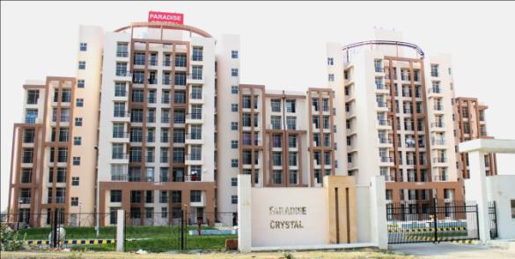
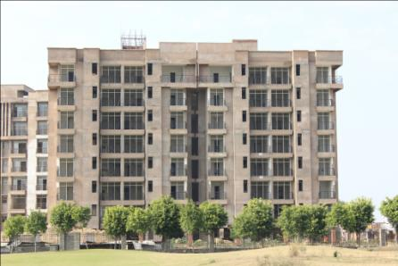
Actual Photographs of some constructed Group Housings in SUSHANT GOLF CITY
Celebrity Gardens
Celebrity Greens
Celebrity Meadows
Paradise Crystal
Santushti Enclave

Slide 18
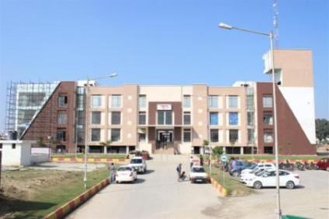
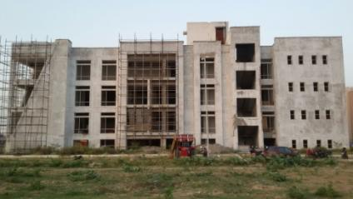
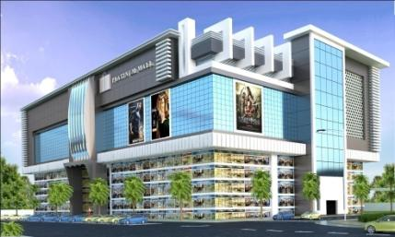
SUSHANT GOLF CITY – COMMERCIAL
Shopping Square, Sec-D2
(Under Construction)
Shopping Square, Sec-D1
Platinum Mall
(New Launch)

Slide 19
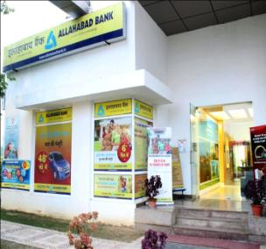
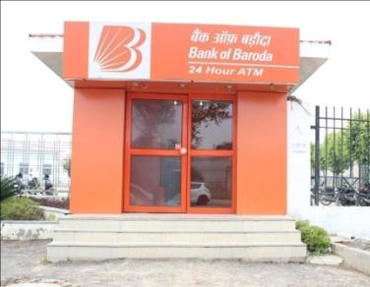




Actual Photographs of some developed AMENITIES And FACILITIES
Ansal ISKCON
Spiritual Centre
Allahabad Bank
BOB ATM
Best Price - Walmart
Police Chowki
Palms Golf Club & Resort
(International Standard 18-hole
Championship Golf Course)

Slide 20





Actual Photographs of Education Institutes in townships
AITM (55124.60 sq.mt.)
Kunkapsskolan School
(16556.25 sq.mt.)
GD Goenka Public School
(17010.47 sq.mt.)
S J International School
(3622.50 sq.mt.)
Seth AnandRam Jaipuria School
(10334.37 sq.mt.)

Slide 21


Developments around Sushant Golf City
Proposed IT City
HCL Technologies, India’s fourth largest information technology (IT) services company, to complete its Rs 1,500 crores Lucknow IT City project by October 2016, which is adjacent to Sushant Golf City.
The project is estimated to provide direct jobs to nearly 25,000 people with indirect employment to 50,000.
http://www.business-standard.com/article/companies/lucknow-it-city-clock-ticking-for-hcl-technologies-115101000175_1.html
Amul Dairy 20 acres land in Lucknow to set up dairy processing plants, with Rs 200 crores investment. Like the Varanasi plant, Lucknow plant will have the capacity to process five lakh litres per day, expandable to 10 LLPD.
In addition to indirect employment, 20,000 new jobs would be created directly approximately 7 lakh farmers families are expected to be benefited, once all four units are established.
http://timesofindia.indiatimes.com/india/Amul-follows-Modi-to-set-up-Rs-200-crore-dairy-plant-in-Varanasi/articleshow/35134336.cms

Slide 22


Developments around Sushant Golf City
Proposed IT City
Cancer hospital in the city would come up over an area of about 50 acres along the Chak Gajaria farm on Sultanpur Road adjacent to Ansal API SUSHANT GOLF CITY .
According to officials, the hospital will turned into a centre of excellence in oral cancer.
Medanta Group investing about Rs 1,000 crores in its super-specialty hospital project coming up in Ansal API Sushant Golf City Lucknow. The proposed hospital spanning 12 acres is projected to start functioning in the next 12 months. The project would comprise a 1,000 bed hospital with 300 critical care beds and offering medical care for 20 different diseases.
The project is likely to provide direct employment opportunities to 25,000 people when fully operational.
http://www.business-standard.com/article/companies/medanta-to-invest-rs-1-000-crore-in-lucknow-hospital-project-115101500820_1.html

Slide 23


Developments around Sushant Golf City
The Lucknow Development Authority has made up its mind to host the dream project, the International Cricket Stadium, in 2015. The project's construction is on in full swing at Gomtinagar Extension. To complete the pitch of stadium and also host a grand state-level match in a trial run this year.
"The construction which started in October 2014 is in full swing and the developer would be able to host international level matches like 20-20, IPL etc in.” International Cricket Stadium also coming up with a first of its kind 'Sports Rehabilitation Centre' for players who get injured during matches.
Area -137 Acres.
Cost – 360 Crores
http://icslko.in/
Lucknow-Sultanpur Highway will be Four Lane:
126 Km highway
4 Lane Highway
Work will Start from Sep 2016
Project Cost – Rs . 1475 Cr.
Project Completion – 2 years

Slide 24

Proposed Layout
Conceptual Layout plan of the Township shown in approved DPR
The layout is complying the land use planning norms as per HI-TECH POLICY AND CONCERNING BYE-LAWS/ GUIDELINES OF MOU

Slide 25
Thank You

